Slide 1
Face Mask Detection
Presented
By
Yatin Bajaj Abhinav Sharma
1810992625 1810992633
Under the Supervision
of
Dr. Amandeep Kaur
Department of Computer Applications
Chitkara University, Punjab

Slide 2
Problem statement and objectives of the project
COVID-19 pandemic caused by novel coronavirus is continuously spreading until now all over the world. The impact of COVID-19 has been fallen on almost all sectors of development. The healthcare system is going through a crisis.
This is a real-time desktop application to automate the process of screening performed in the public areas to enforce people to wear masks.
However, by this application people without masks will be detected through CCTV surveillance in the public areas, and it will be easy for the local authorities to take action on the people not following the COVID-19 guidelines.

Slide 3
Objective:
To identify the person on image/video stream wearing face mask with the help of computer vision and deep learning algorithm by using the Tensor Flow , Keras library.
Train Deep learning Convolutional Neural Network (ConvNet/CNN) Model (MobileNetV2) using Transfer learning.

Slide 4
Functionality
It is using a subset of computer vision i.e. object detection, it is an automated way of locating objects with respect to the background.
To perform object detection, there are some libraries by which we could implement object detection i.e. openCV and tensorflow.
openCV is used to access and manipulate data(video stream through webcam) and tensorflow is used to train the model with data handling. OpenCV package read an image and perform certain image processing techniques.
Keras library contains some API’s that are used by tensorflow to train the model.

Slide 5
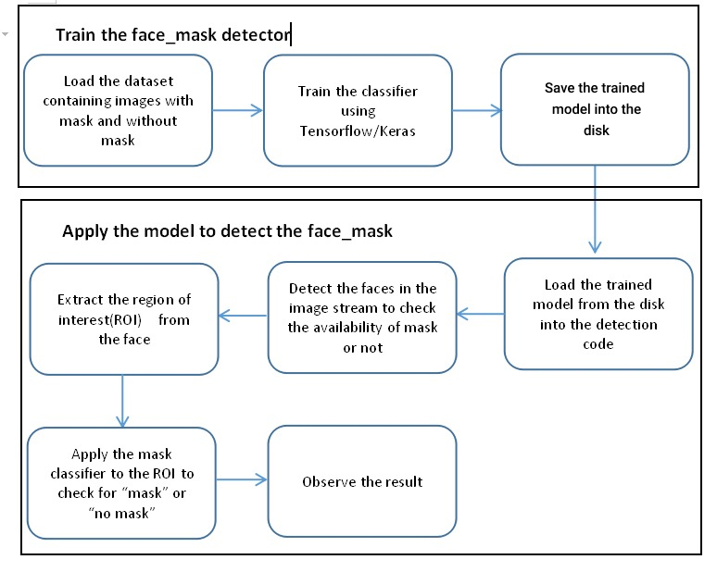
Architecture

Slide 6
Database Design and Embedding
Presently This project is a module for now, which is based on a local database management system, i.e. we need to give the path of the data set from our system to train the model. This project can afterwards be embedded with any desktop application and mobile application. Also, this project can work well with web-based applications and can be fused with any database of our choice. This project can be put into use with CCTV cameras with the help of RTSP(Real Time Streaming Protocol) URL’s, so that it can function for traffic regulation departments.

Slide 7
Thank you

